Slide 1
DATA ANALYSIS - Fake News Classification DATASET

Slide 2
ROADMAP
DATA CLEANING
DATA WRANGLING
DATA ANLYSIS & OBSERVATION
1
3
5
2
4
DATA HANDLING
DATA TRANSFORMATION

Slide 3
INITIAL DATA CLEANING
Used word cloud to analyse the most common words used in fake and True categories in label column
Convert text into vectors using TF-IDF
Instantiate MultinomiaLNB classifier
Split feature and Label
Train and split on the data set
Train and predict
Plot confusion matrix heatmap
Methodology
Data cleaning and removing the unwanted columns from the data
Combining the true and Fake into a single Label column and concatenate the 2 data sets with pandas and numpy
Checking the length and count of the messages
Used label encoding to add values to label_ categories true and false
Used stop words and word net lemmatizer to clean the data

Slide 4
INITIAL DATA CLEANING
Found out the shape and size of the data
2. Added a Fake category under label to the Fake.csv data set
3.Added a true label to the true.csv data set
4.Used concat function to combine two data sets. And two labels: True and Fake
5. Used label encoder to add 0 and 1 values to label column, (0 being Fake and 1 is true)

Slide 5
INITIAL DATA CLEANING
Finding out if there are any special characters in the object data type
replaced any missing values with blank values
Data set had 209 duplicate value and removed them

Slide 6
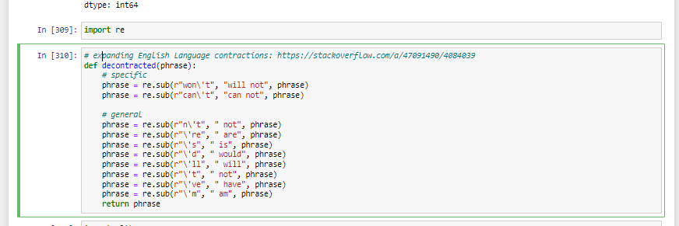
DATA WRANGLING
Working with regular expressions and removing characters
"

Slide 7
DATA WRANGLING
Importing stopwords and word net lemmatizer from nltk
Import tqm library - use it to process the title, text and subject column

Slide 8
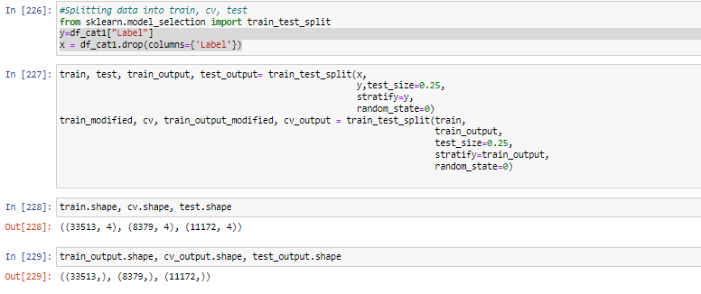
DATA MODELLING
Splitting the data into train and set 2 times

Slide 9
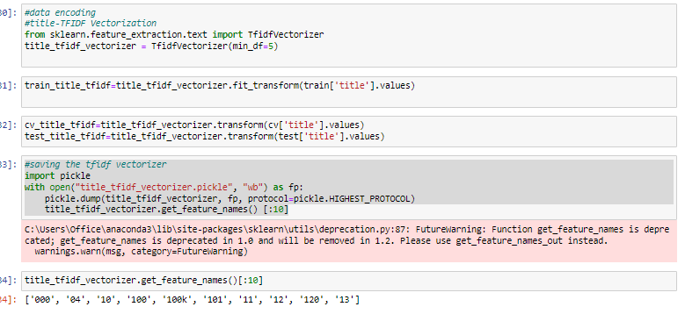
DATA MODELING-DATA ENCODING WITH TDF VECTORIZATION

Slide 10
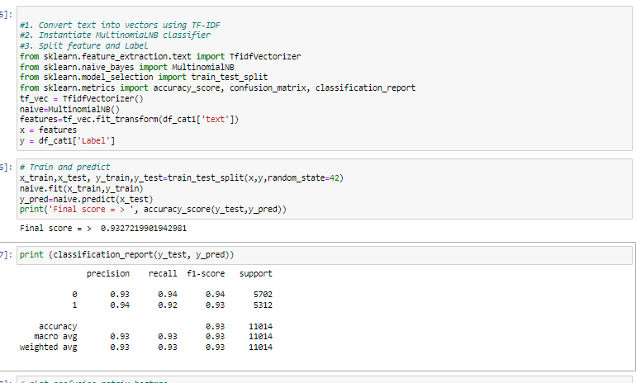
DATA ANALYSIS - Accuracy score and classification report

Slide 11
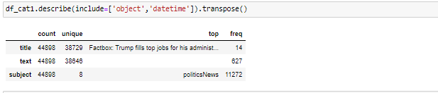
CONCLUSION
23. Finding out the unique value in object type column

Slide 12
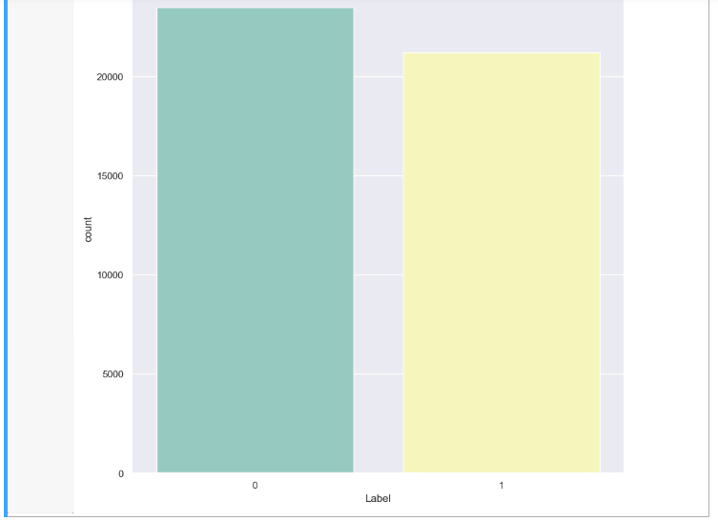
CONCLUSION
Dividing labels into 0 and 1. (0 being Fake and 1 is true). Around 2800 for Fake and 2300 for true

Slide 13
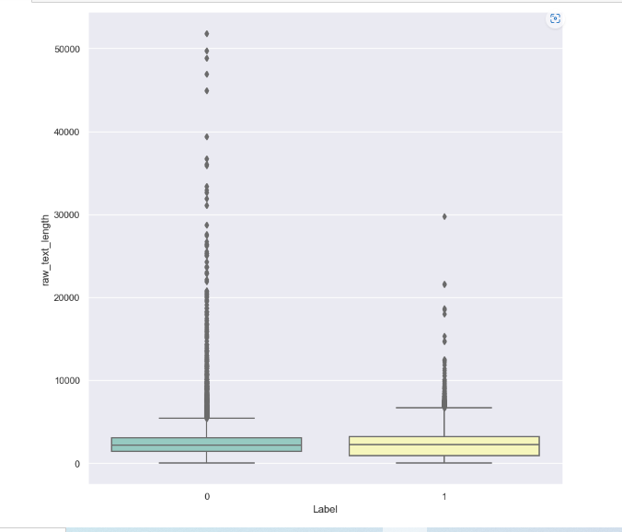
CONCLUSION
Raw text length for both labels 0 and 1 . (0 being Fake and 1 is true)
5500 for Fake and around 3000 for true

Slide 14
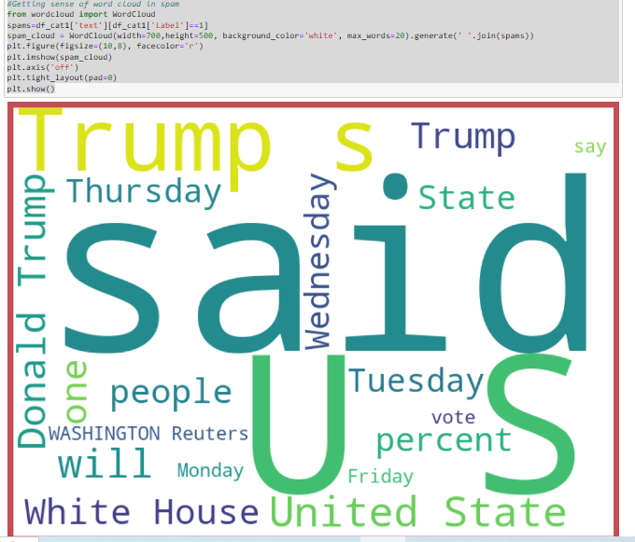
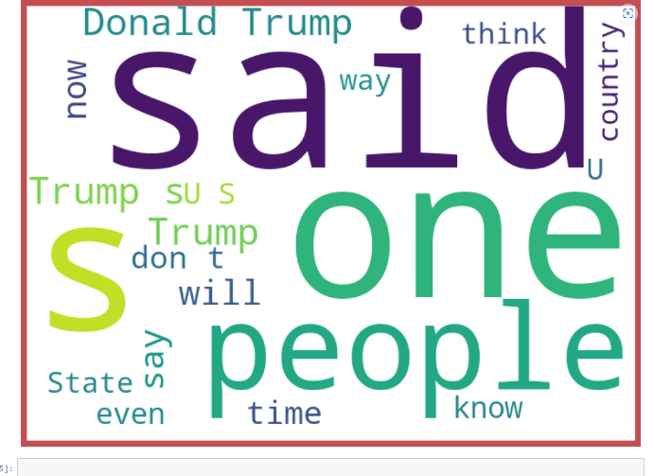
CONCLUSION- word cloud for Fake and true

Slide 15
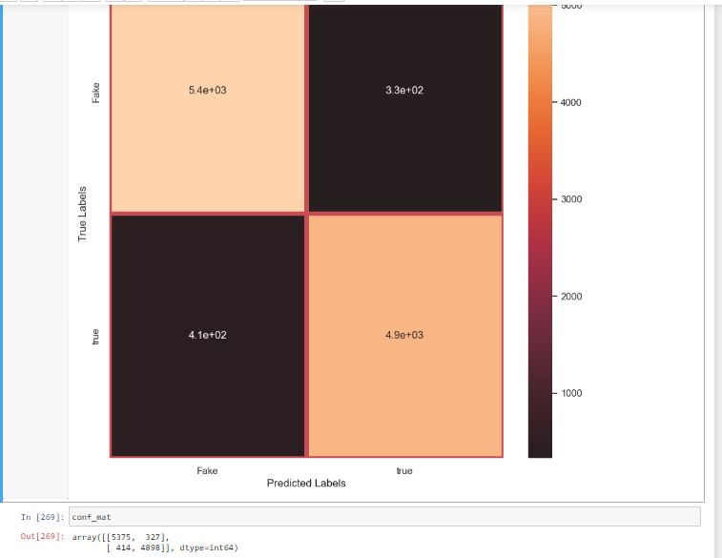
CONCLUSION- Correlation Marix

Slide 16
THANKS!

